Slide 1


Introduction
COMPSCI 453 Computer Networks
Professor Jim Kurose
College of Information and Computer Sciences
University of Massachusetts
Overview. What is the Internet? What is a protocol?
Network edge
Network core
Performance: loss, delay, throughput
Layering, encapsulation, service models
Networks under attack
History
Class textbook:
Computer Networking: A Top-Down Approach (8th ed.)
J.F. Kurose, K.W. Ross
Pearson, 2020
http://gaia.cs.umass.edu/kurose_ross

Slide 2
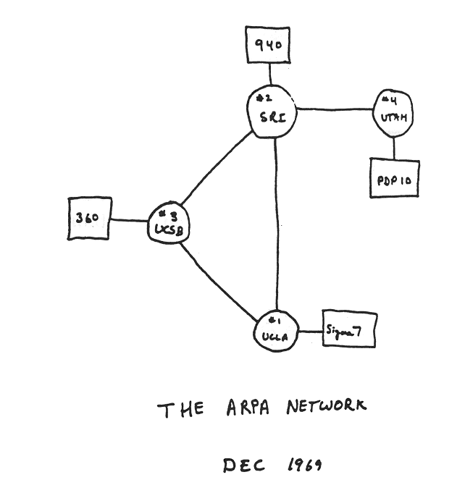
Internet history
1961-1972: Early packet-switching principles
1961: Kleinrock - queueing theory shows effectiveness of packet-switching
1964: Baran - packet-switching in military nets
1967: ARPAnet conceived by Advanced Research Projects Agency
1969: first ARPAnet node operational
1972:
ARPAnet public demo
NCP (Network Control Protocol) first host-host protocol
first e-mail program
ARPAnet has 15 nodes

Slide 3
Internet history
1972-1980: Internetworking, new and proprietary networks
1970: ALOHAnet satellite network in Hawaii
1974: Cerf and Kahn - architecture for interconnecting networks
1976: Ethernet at Xerox PARC
late70’s: proprietary architectures: DECnet, SNA, XNA
1979: ARPAnet has 200 nodes
Cerf and Kahn’s internetworking principles:
minimalism, autonomy - no internal changes required to interconnect networks
best-effort service model
stateless routing
decentralized control
define today’s Internet architecture

Slide 4
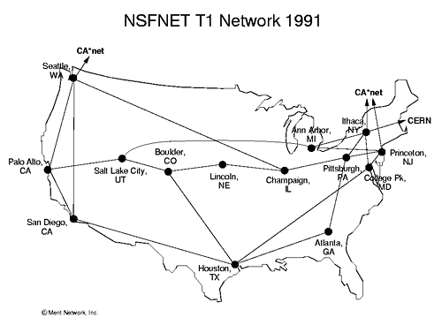
Internet history
1980-1990: new protocols, a proliferation of networks
1983: deployment of TCP/IP
1982: smtp e-mail protocol defined
1983: DNS defined for name-to-IP-address translation
1985: ftp protocol defined
1988: TCP congestion control
new national networks: CSnet, BITnet, NSFnet, Minitel
100,000 hosts connected to confederation of networks

Slide 5
Internet history
1990, 2000s: commercialization, the Web, new applications
early 1990s: ARPAnet decommissioned
1991: NSF lifts restrictions on commercial use of NSFnet (decommissioned, 1995)
early 1990s: Web
hypertext [Bush 1945, Nelson 1960’s]
HTML, HTTP: Berners-Lee
1994: Mosaic, later Netscape
late 1990s: commercialization of the Web
late 1990s – 2000s:
more killer apps: instant messaging, P2P file sharing
network security to forefront
est. 50 million host, 100 million+ users
backbone links running at Gbps

Slide 6
Internet history
2005-present: scale, SDN, mobility, cloud
aggressive deployment of broadband home access (10-100’s Mbps)
2008: software-defined networking (SDN)
increasing ubiquity of high-speed wireless access: 4G/5G, WiFi
service providers (Google, FB, Microsoft) create their own networks
bypass commercial Internet to connect “close” to end user, providing “instantaneous” access to social media, search, video content, …
enterprises run their services in “cloud” (e.g., Amazon Web Services, Microsoft Azure)
rise of smartphones: more mobile than fixed devices on Internet (2017)
~18B devices attached to Internet (2017)

Slide 7
Chapter 1: summary
We’ve covered a “ton” of material!
Internet overview
what’s a protocol?
network edge, access network, core
packet-switching versus circuit-switching
Internet structure
performance: loss, delay, throughput
layering, service , encapsulation
networks under attack
history
You now have:
context, overview, vocabulary, “feel” of networking
more depth, detail, and fun to follow!

Slide 8

Introduction
COMPSCI 453 Computer Networks
Professor Jim Kurose
College of Information and Computer Sciences
University of Massachusetts
Overview. What is the Internet? What is a protocol?
Network edge
Network core
Performance: loss, delay, throughput
Layering, encapsulation, service models
Networks under attack
History
Class textbook:
Computer Networking: A Top-Down Approach (8th ed.)
J.F. Kurose, K.W. Ross
Pearson, 2020
http://gaia.cs.umass.edu/kurose_ross
Video: 2020, J.F. Kurose, All Rights Reserved
Powerpoint: 1996-2020, J.F. Kurose, K.W. Ross, All Rights Reserved

